Slide 1
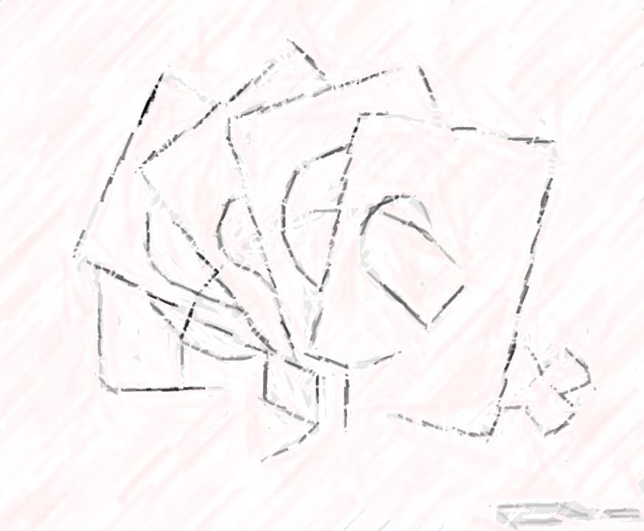
Stage 12
Conditionals with Cards

Slide 2
Objective
Define circumstances when certain parts of programs should run and when they shouldn’t
Determine whether a conditional is met based on criteria
Traverse a program and predict the outcome, given a set of input

Slide 3
Vocabulary

Slide 4
Example
If you can be completely quiet for thirty seconds you will be rewarded with one of the following:
Have 5 minutes of free time on the computer
Have 5 minutes to talk with friends
Have a mint
If you are not quiet for a full thirty seconds you do not get a reward.
Lets give this a try.

Slide 5
Example
What was the condition of the reward?
The condition was IF you were quiet for 30 seconds:
If you were, the condition would be true, and you would get the rewards
If you weren’t, the condition would be false, so the reward would not apply.

Slide 6
2nd Example
Can we come up with another conditional?
If every comes to class on time tomorrow, we will listen to music during work time.

Slide 7
IF…Else
Sometimes, we want to have an extra condition, in case the “IF” statement is not true.
This extra condition is called an “ELSE” statement.
When the “IF” statement isn’t met, we can look at the “ELSE” for what to do
If I draw a 7, everybody claps. Or Else, everyone says “Awwwwwwwwwe”.
Let’s try it.

Slide 8
If…Else
What was the if?
Draw a 7, everyone claps
What was the else?
Not draw a 7, everyone says awe
Which condition was met?

Slide 9
Wait there’s more!!
Believe it or not, we have even more options!
What if I wanted you to clap if I draw a 7, or else if I draw something less than seven you say “YAY”, or else you say “Awwwwwwwe”?
This is why we have the terms: If, Else If, & Else
If is the first condition
Else-if gets looked at only if the “IF” isn’t true
Else gets looked at only if nothing before it is true

Slide 10
Game Time – Conditionals with Cards
I need 2 volunteers to demonstrate!

Slide 11
Game Time – Conditionals with Cards

Slide 12
Game Time – Conditionals with Cards
Get in groups of 4
Make up conditionals with cards
Play your game (Get cards from Ms. Mills)
Share game conditionals with class

Slide 13
Computer Time
Login
Username: bsmedia
Password:
Press Enter
Open code.org icon to Mozilla Firefox
Login into code.org
Start Stage 12 Conditionals with Cards
Answer the one question
Stop at Stage 13 Bee: Conditionals

